Slide 1
Chapter 5 Combinational Logic aNalysis
组合逻辑分析

Slide 2
Example
For each circuit, determine if the LED should be on or off.
(a) (b) (c)
Solution
Circuit (a): XOR, inputs agree, output is LOW, LED is ON.
Circuit (b): XNOR, inputs disagree, output is LOW, LED is ON.
Circuit (c): XOR, inputs disagree, output is HIGH, LED is OFF.

Slide 3


Implementing Combinational Logic
$$X=\overline{A}B\overline{C}+A\overline{B}D+B\overline{D}E$$
Implementing a SOP expression is done by first forming the AND terms; then the terms are ORed together.
E.g. Show the circuit that will implement the Boolean expression$X=\overline{A}B\overline{C}+A\overline{B}D+B\overline{D}E$. (Assume that the variables and their complements are available.)
A
B
C
A
B
D
B
D
E
First AND
Then OR

Slide 4


Karnaugh Map Implementation
For basic combinational logic circuits, the Karnaugh map can be read and the circuit drawn as a minimum SOP.
1. The vertical group is read $\overline{A}\overline{C}$
2. The horizontal group is read $\overline{A}B$
A
C
X =
A
C
+
A
B
A
B
How about implement this form using only NAND gates?

Slide 5
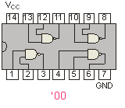
NAND Logic
Fixed Function Logic
Example
Convert the circuit in the previous example to one that uses only NAND gates.
Solution
Recall from Boolean algebra that double inversion cancels. By adding inverting bubbles to above circuit, it is easily converted to NAND gates:
A
The logic is easy to read if you (mentally) cancel the two connected bubbles on a line.
C
X =
A
C
+
A
B
A
B
The equivalent form of NAND gate.

Slide 6
Universal Gates 通用逻辑门
NAND/NOR gates are sometimes called universal gates because they can be used to produce the other basic Boolean functions
A
A
A
AB
A
A
A
A + B
B
B
Inverter
AND gate
Inverter
OR gate
A
A
A + B
AB
B
B
OR gate
AND gate

Slide 7
Bubble logic*

Slide 8
Bubble logic
Active high
Active high
Active low
Active low

Slide 9
Bubble logic
Active high
Active high
Active low
Active low

Slide 10
Bubble logic

Slide 11
Bubble logic
The logic is easy to read if you (mentally) cancel the two connected bubbles on a line.
A
C
X =
A
C
+
A
B
A
B

Slide 12
Bubble logic
Don’t match
Match
Z.H = W.H(X.H+Y.H)

Slide 13
Bubble logic
Convert: start from the output gate.
H=D+C(A’+B’)

Slide 14
COMBINATIONAL LOGIC
组合逻辑

Slide 15
DEFINITION OF COMBINATIONAL LOGIC
Logic circuits without feedback from output to the input, constructed from a functionally complete gate set, are said to be combinational.
·
Combinational Logic Functions
·
Inputs
·
·
Outputs
·
·

Slide 16
General logic design sequence
Problem
Statement
问题陈述
Truth Table
Construction
构造真值表
Switching Equations
Written
写开关方程
Logic Circuit
Built
构造逻辑电路
Logic Diagram
Drawn
画逻辑图
Equations(s)
Simplified
方程化简

Slide 17
PROBLEM STATEMENTS TO TRUTH TABLES

Slide 18
Example 1: Conveyor system
An electric motor powering a conveyor used to move material is to be turned on when one of two operators is in position, if material is present to be moved and if the protective interlock switch is not open.
Input and output variables are to be expressed in binary; that is, if operator 1 is in position then the associated variable is a logical 1. The motor is running (on) if its output control variable is a 1, and the motor is off if the variable is a 0.

Slide 19
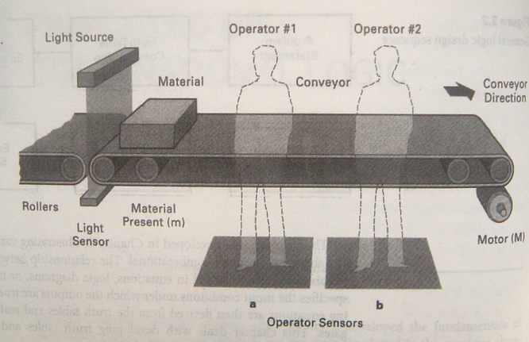
Example 1: Conveyor system

Slide 20
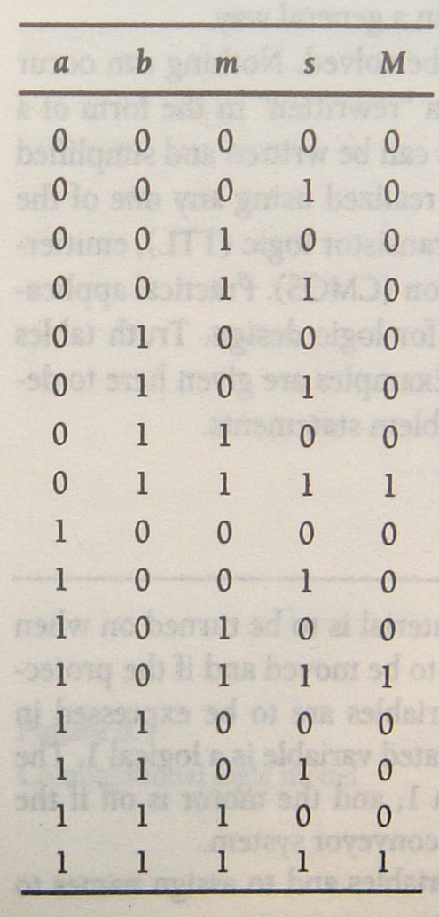
Example 1: Conveyor system
Identify the input and output variables and to assign names to them.
a, operator 1 is in position
b, operator 2 is in position
s, means the interlock switch is closed
m, means material is present.
M, the signal to turn the motor on and off.
M=a’bms+ab’ms+abms

Slide 21
Example 2: Conveyor system
Define Priority: M₁ > M₂ > M₃

Slide 22
Example 2: Conveyor system
S₃ | S₂ | S₁ | M₄ | M₃ | M₂ | M₁
0 | 0 | 0 | 0 | 0 | 0 | 0
0 | 0 | 1 | 1 | 0 | 0 | 1
0 | 1 | 0 | 1 | 0 | 1 | 0
0 | 1 | 1 | 1 | 0 | 0 | 1
1 | 0 | 0 | 1 | 1 | 0 | 0
1 | 0 | 1 | 1 | 0 | 0 | 1
1 | 1 | 0 | 1 | 0 | 1 | 0
1 | 1 | 1 | 1 | 0 | 0 | 1

Slide 23
Summary
The process of converting a verbal problem statement into a truth table
Determine the input variables and output variables that are involved
Assign mnemonic or letter or number symbols to each variable
determine the size of the truth table; how many input combinations exist:
2^{x}=y x=number of input variables, y=number of combinations.
Construct a truth table containing all of the input variable combinations
By careful reading of the problem statement determine the combinations of inputs that cause a given output to be true

Slide 24
HOMEWORK
An automobile system is to be designed that will sound an alarm under certain conditions. The alarm is to sound if the seat belt is not fastened and the engine is running, or if the lights are left on when the key is not in the ignition, or if the key is in the ignition, the engine is not running and the driver’s door is open. Determine the number of inputs and outputs, assign names to variables, and construct a truth table that describes the system.

Slide 25
Multiple output function*
Sharing the common items can reduce the total number of gates.
E.g. F₁(a,b,c)=∑m(2,6,7) F₂(a,b,c)=∑m(1,3,7)
ab
ab
c
00
01
11
10
c
00
01
11
10
F₁(a,b,c)=bc’+abc
F₂(a,b,c)=a’c+abc
00
 | 1 | 1
 |  | 1
6
4
00
1 | 1 | 1
0
2
0
2
6
4
01
1
3
7
5
01
1
3
7
5
F₁(a,b,c)=bc’+ab
F₂(a,b,c)=a’c+bc

Slide 26
F₁(a,b,c)=bc’+ab
F₂(a,b,c)=a’c+bc
F₁(a,b,c)=bc’+abc
F₂(a,b,c)=a’c+abc
Shared item

